Slide 1
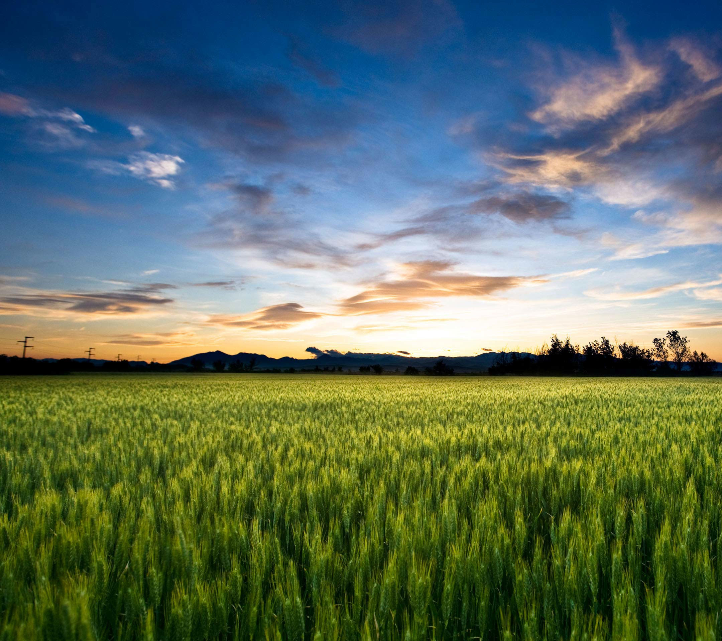
SMART AGRICULTURE SYSTEM
BASED ON IOT
PRESENTED BY
PARTH PATEL
(parthpatelvvn@gmail.com)

Slide 2
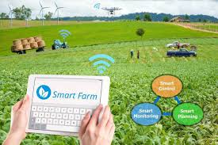
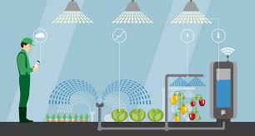
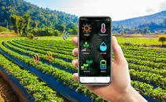
What is Smart Farming?
Smart farming is a technique used to improve the crop production using latest technolgy

Slide 3
Why Smart Farming?
To increase crop production
To decrease human efforts
To increase crop quality
To reduce Crop loses
To take preventive measures about weather changes

Slide 4
Project analysis slide 2
Basic Chart
IBM CLOUD
IBM SIMULATOR SENSOR
UI
NODE-RED
IBM WATSON IoT PLATFORM
PYTHON IDLE
OPEN WEATHER API

Slide 5
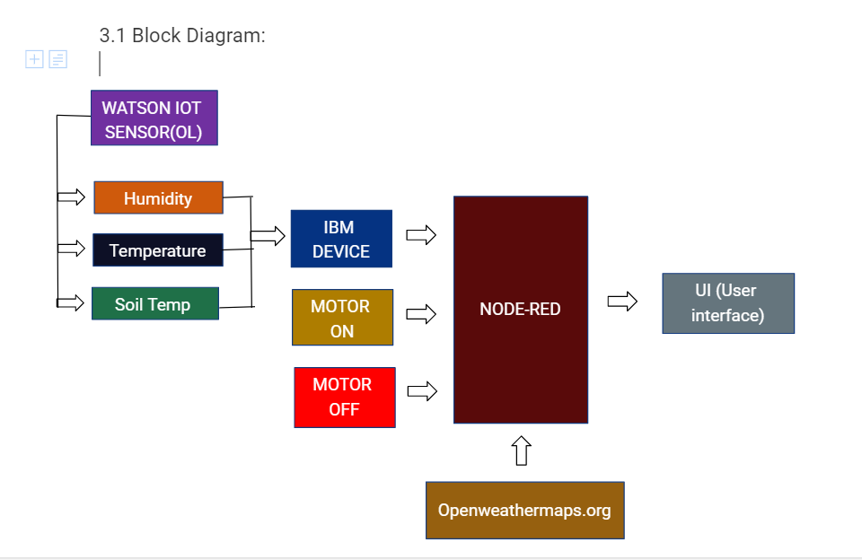

Slide 6
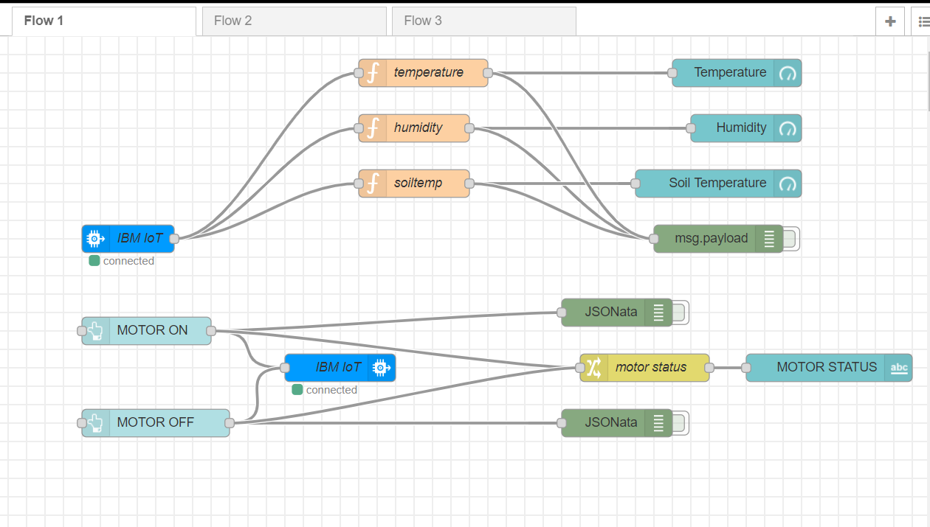
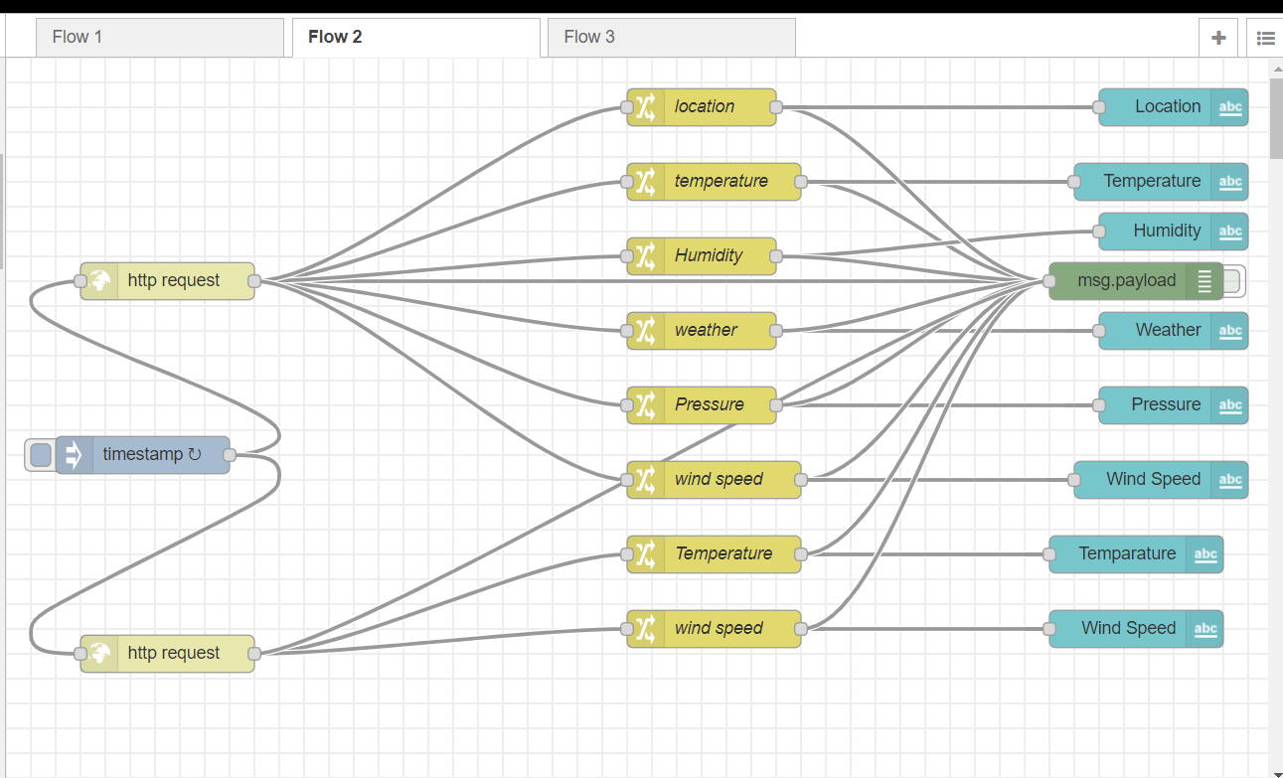
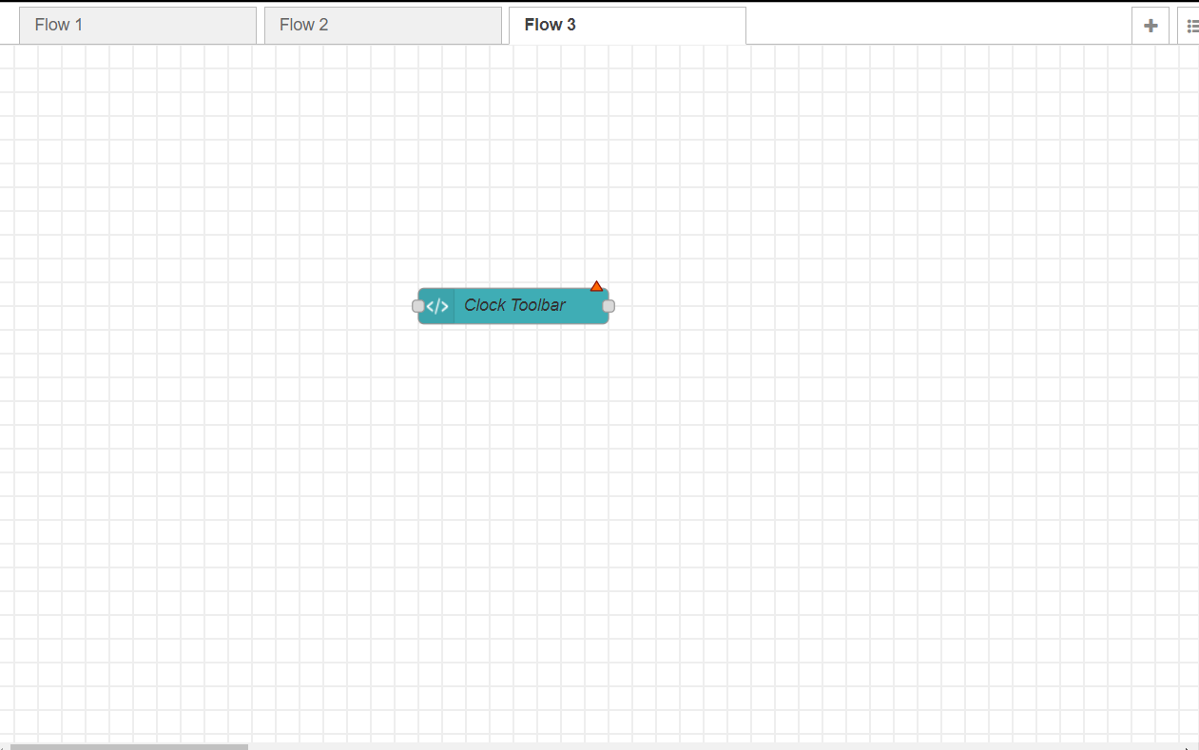
Node-Red

Slide 7
Conclusion:
Smart agriculture is really helpful to farmers and provides a great source to predict the upcoming weather forecast and prevent a lot of crop damage and loses and to reduce few human efforts of switching the motor.

